Slide 1
Data Mining
Probabilistic Graphical Model (Topic Modeling)
Lectured by Shangsong Liang
Sun Yat-sen University
Originally produced by Xiangliang Zhang, King Abdullah University of Science and Technology

Slide 2
Goal of Topic Modeling
Automatically discover the topics from a collection of documents
One paper may have several topics
One topic is a distribution over words
Benefits:
Discover hidden themes
Helps on understanding and annotating documents
Reduce dimensionality
Popular models: LDA, pLSA (or pLSI) etc
2
Notes:
目的：推断出每个文档中主题的比例，以及每个主题的词语的分布；

Slide 3

Probabilistic Topic Modeling
Input: An unorganized collection of documents
Output: An organized collection, and a description of how

Slide 4
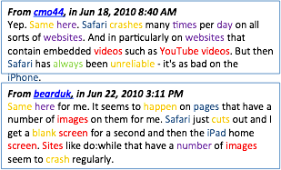
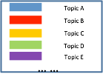
Model Document as a sample of mixed topics

Slide 5
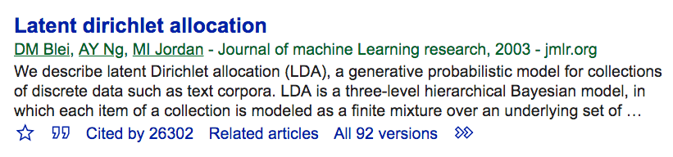
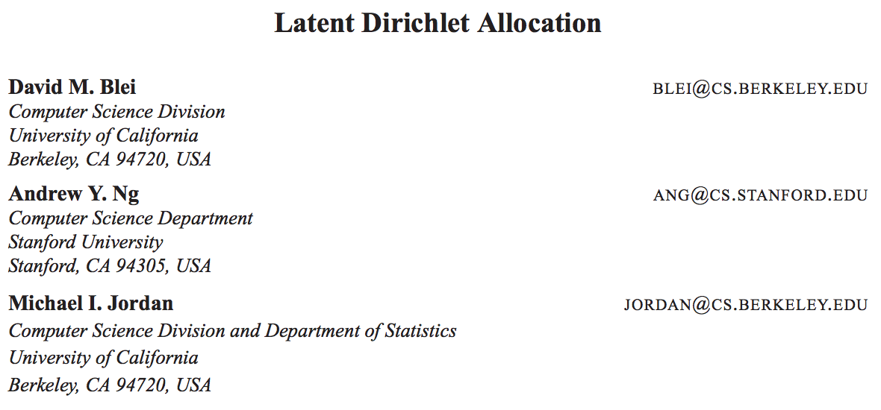
LDA: Latent Dirichlet Allocation
5

Slide 6
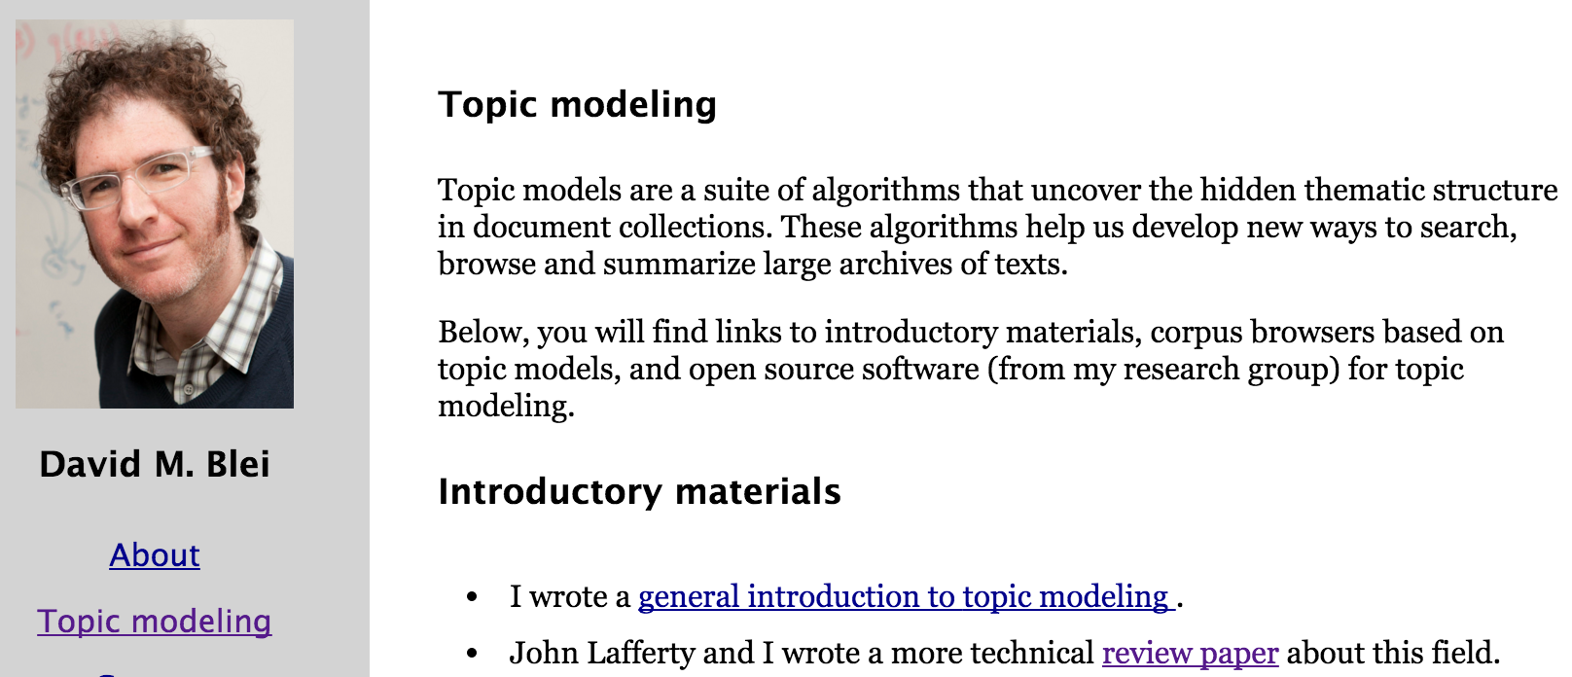
Topic Modeling
https://www.cs.princeton.edu/~blei/topicmodeling.html
6
Notes:
https://www.quora.com/What-is-the-difference-between-NMF-and-LDA-Why-are-the-priors-of-LDA-sparse-induced
ABOUT
NMF, PLSA, LDA!!!
http://stefansavev.com/blog/lsi-slash-lsa-slash-svd-a-bit-of-history/
SVD, LSI, LSA, LDA
http://pages.cs.wisc.edu/~jerryzhu/cs769/latent.pdf
Dimensionality Reduction and Latent Topic Models

Slide 7
Topic Models vs DR techniques
What makes topic models different?
A topic model is a generative model
The model specifies a simple probabilistic procedure by which documents can be generated.
Invert this process --- infer the set of topics that were responsible for generating a collection of documents
7
Notes:
https://www.quora.com/What-is-the-difference-between-NMF-and-LDA-Why-are-the-priors-of-LDA-sparse-induced
ABOUT
NMF, PLSA, LDA!!!
http://stefansavev.com/blog/lsi-slash-lsa-slash-svd-a-bit-of-history/
SVD, LSI, LSA, LDA
http://pages.cs.wisc.edu/~jerryzhu/cs769/latent.pdf
Dimensionality Reduction and Latent Topic Models

Slide 8
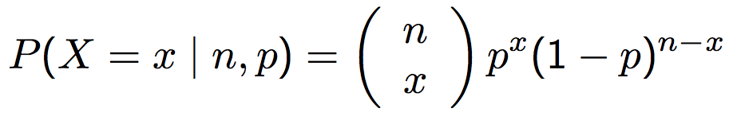
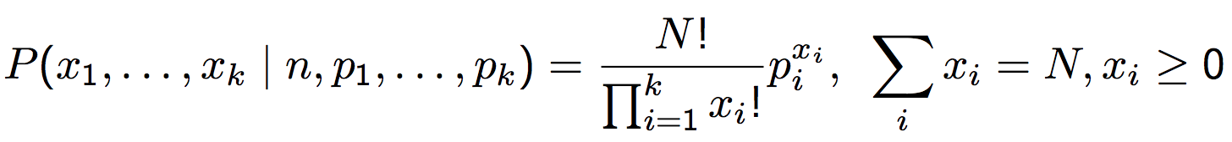
Useful Distributions
Modeling the probability of counts for rolling a k-sided dice n times.
k exclusive outcomes | k=2 | k>2
n=1 (one trial) | Bernoulli (两点分布) | Categorical P(x=i)=p_{i} , p₁+p₂+…+p_{k}=1
n>1 (n independent trials) | Binomial | Multinomial
NOTE: in NLP, the categorical and multinomial distributions are conflated, and it is common to speak of a "multinomial distribution" when a categorical distribution is actually meant.
Its outcome can be expressed as expressed as a "1-of-K" vector (a vector with one element containing a 1 and all other elements containing a 0)
Notes:
outcome of a categorical distribution can be expressed as a "1-of-K" vector (a vector with one element containing a 1 and all other elements containing a 0)
This stems from the fact that it is sometimes convenient to express the outcome of a categorical distribution as a "1-of-K" vector (a vector with one element containing a 1 and all other elements containing a 0) rather than as an integer in the range {\displaystyle 1\dots K} 1 \dots K; in this form, a categorical distribution is equivalent to a multinomial distribution over a single trial.

Slide 9
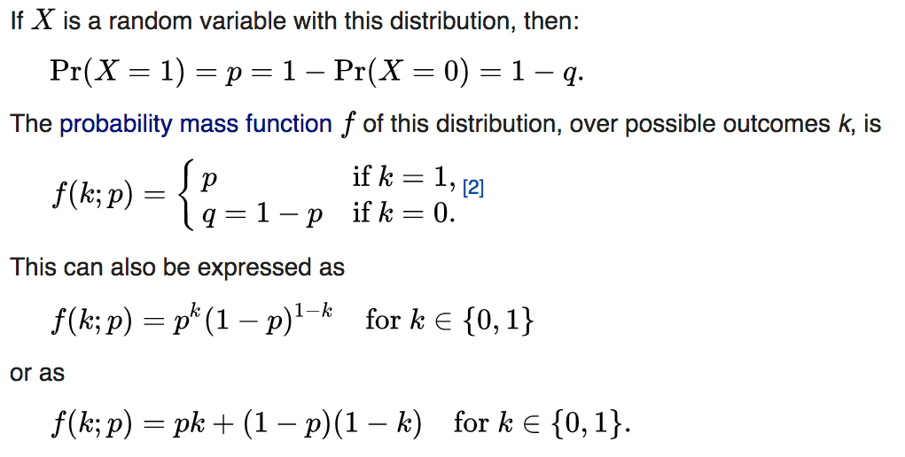
Bernoulli distribution

Slide 10
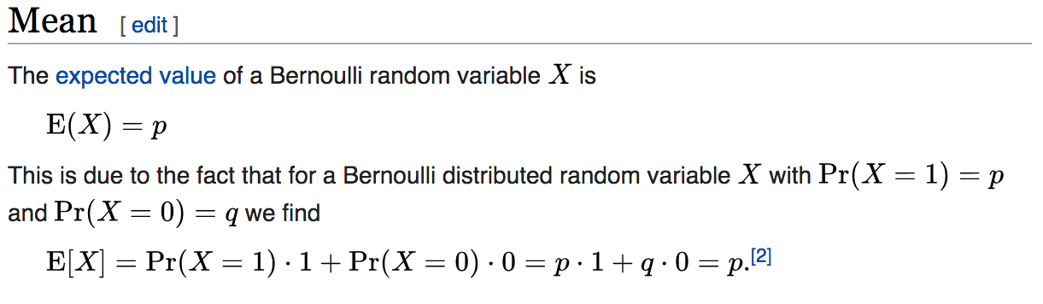
Bernoulli distribution

Slide 11
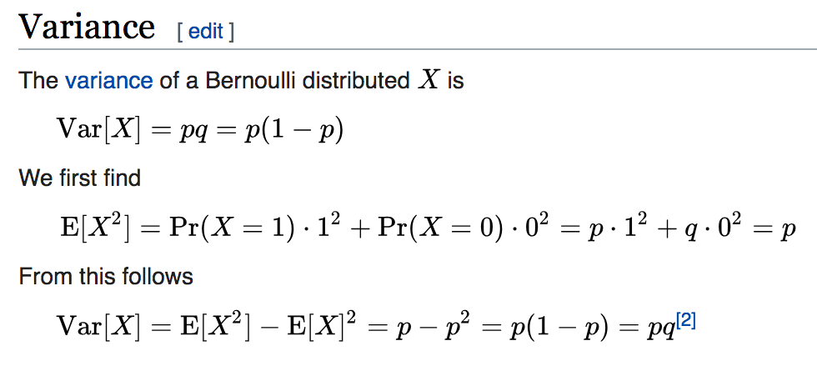
Bernoulli distribution

Slide 12
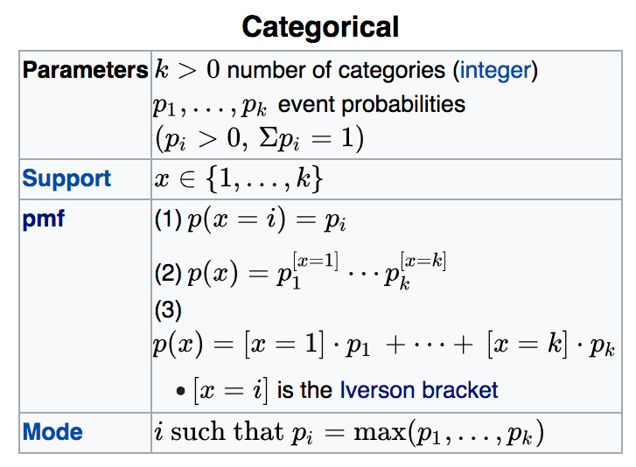
Categorical distribution
Notes:
这一页看不是太懂

Slide 13
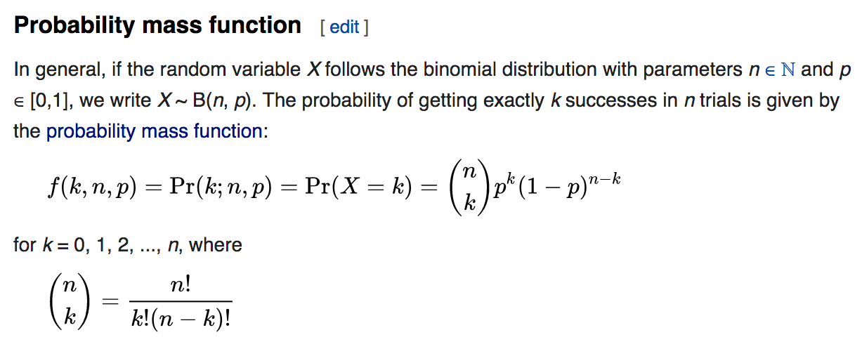
Binomial distribution

Slide 14
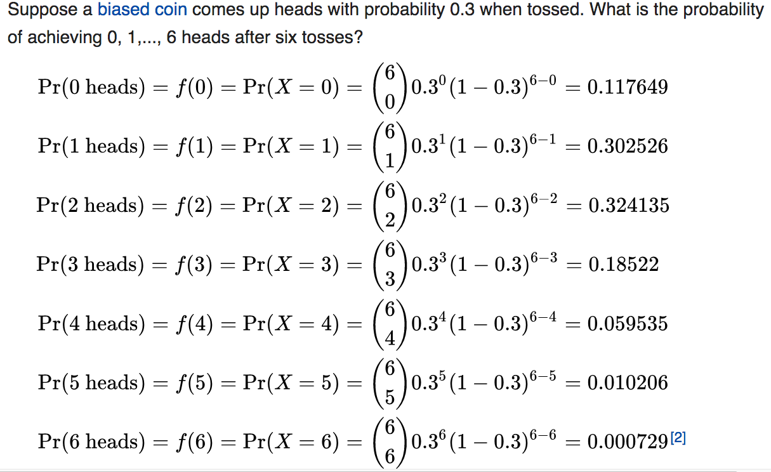
Example of Binomial distribution

Slide 15
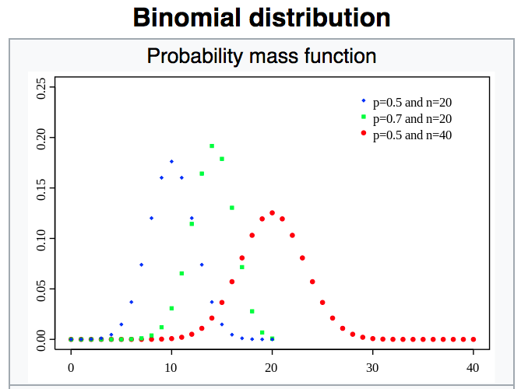
Binomial distribution

Slide 16
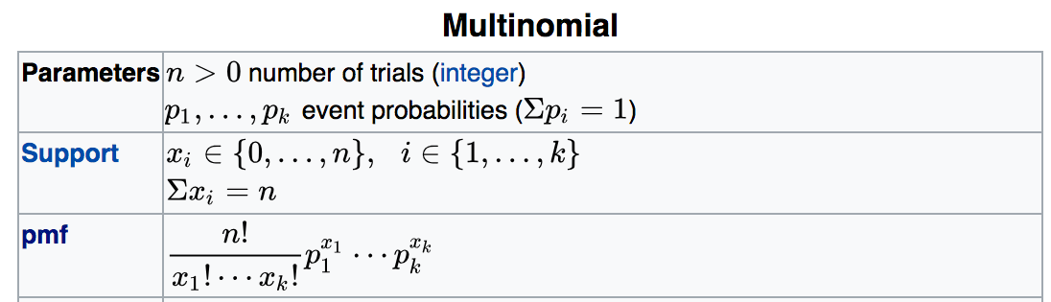
Multinomial distribution

Slide 17
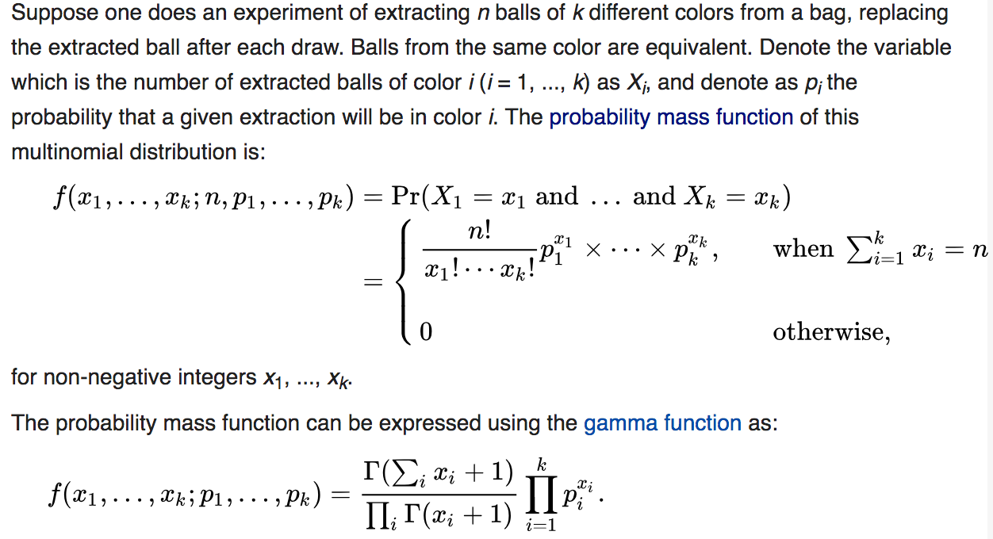
Multinomial distribution

Slide 18
Intuition
How to generate (write) a document? For each word
First picking a topic, according to a multinomial distribution; e.g., pick the food topic with 1/3 probability and the cute animals topic with 2/3 probability).
Using the topic to generate the word itself, according to the topic’s multinomial distribution; e.g., if we selected the food topic, we might generate the word “broccoli” with 30% probability, “bananas” with 15% probability, and so on.
18

Slide 19
Generative vs Discriminative Model
Generative | Discriminative
Model how the data is generated | Learn the (hard or soft) boundary between classes
There is a generative process | There is a decision boundary
Mixture Gaussian Model LDA | SVM Linear classification
19

Slide 20
Recall SVD
A = U S V^{T} - example:
retrieval
inf.
lung
data
brain
CS
=
x
x
MD
20

Slide 21
pLSI, probabilistic LSI (aspect model)
Hofmann,1999
A generative model following LSI (SVD)
For each document d
Pick a topic z, according to P(z|d)
Pick a word w, according to P(w|z)
P(z|d), P(w|z) can be found by maximizing (log) likelihood based on EM algorithm.
c(d,w)
P(z|d)
P(w|z)
21

Slide 22
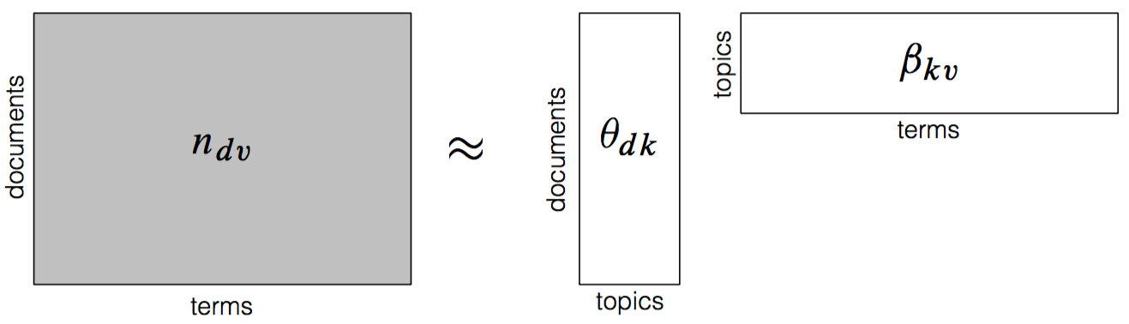
Latent Semantic Analysis (LSA)
(Deerwester et al., 1990)
This is the seminal work that launched topic modeling
Treat a collection as a document by term matrix of TFIDF (Term Frequency-Inverse Document Frequency) scores
Choose a number of topics, and SVD (Singular Value Decomposition) on the matrix
This results in
a matrix of per-document topic weights
a matrix of per-topic term weights

Slide 23
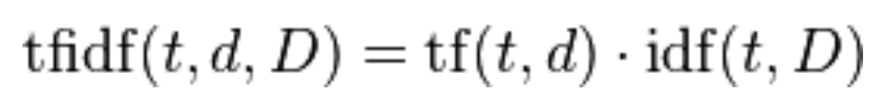
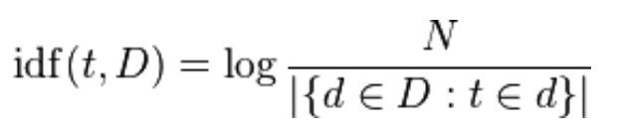
TFIDF (Term Frequency-Inverse Document Frequency)
TFIDF is calculated as

Slide 24
pLSI vs LSI (SVD)
Different objective function
In LSI, min
which corresponds to an implicit additive Gaussian noise assumption on (possibly transformed) counts.
In pLSI, maximize the likelihood function of multinomial sampling, which corresponds to a minimization of the cross entropy or Kullback-Leibler divergence between the empirical distribution and the model
24
See more from “Probabilistic Latent Semantic Analysis”, Thomas Hofmann (SIGIR’99)
https://arxiv.org/pdf/1301.6705.pdf

Slide 25
pLSI discussion
Assuming nothing on p(z|d)
Having k*V+k*n parameters (increasing with the number of documents and the size of vocabulary)
LDA will resolve this issue!
25

Slide 26
Outline
LDA model
Model Inference
LDA discussion
26

Slide 27
LDA, a mixed-membership model
All the documents in the collection share the same set of topics
Each document exhibits those topics in different proportion, rather than associating with one topic
The per-document topic distribution follows another distribution!
27

Slide 28
Document generation process
For each document in the collection, we generate the words in a two-stage process.
Randomly choose a distribution over topics.
For each word in the document
Randomly choose a topic from the distribution over topics in step #1.
Randomly choose a word from the corresponding distribution over the vocabulary.
28

Slide 29
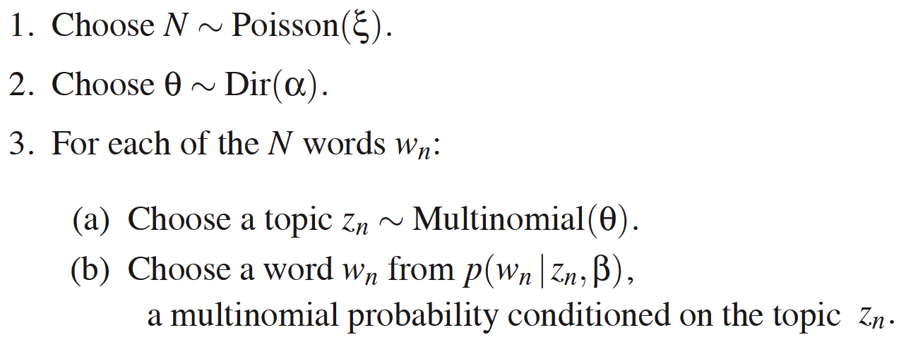
Document generation process
For each document,
29

Slide 30
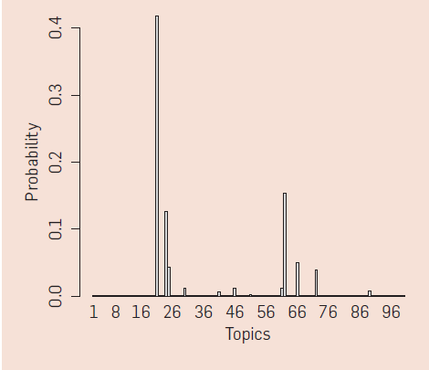
θ Distribution
θ is the parameter of a multi-nominal (actually categorical) distribution, for determining a topic, z
The per-document topic distribution (θ)
30

Slide 31
Dirichlet Prior
There is a categorical distribution with unknown parameter vector θ.
Treat this parameter as a random variable, following a distribution (which distribution is appropriate? Dirichlet distribution). -- This Dirichlet distribution is called prior distribution.
To estimate θ, compute its distribution after incorporating the knowledge gained from the observed data. – This distribution is called the posterior distribution of the parameter.
The posterior distribution is also Dirichlet! i.e., Dirichlet distribution is the conjugate prior distribution of the categorical distribution (and also the multinomial distribution)
P(θ|X) ~ P(X|θ)P(θ)
31

Slide 32
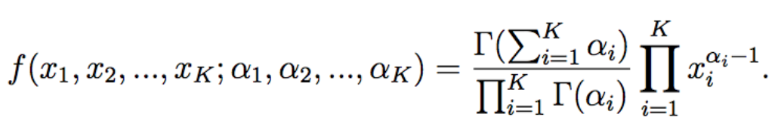
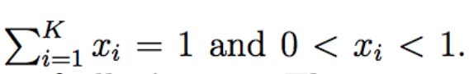
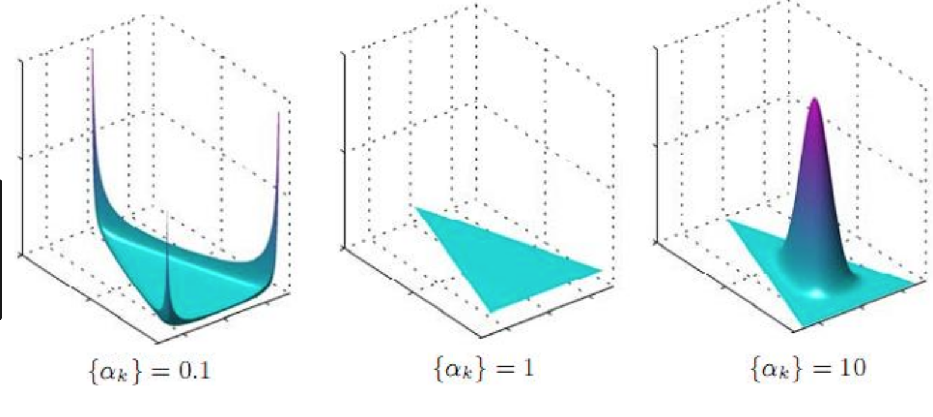
Dirichlet Distribution
Dirichlet is parameterized by a vector α (concentration parameter)
where
32

Slide 33
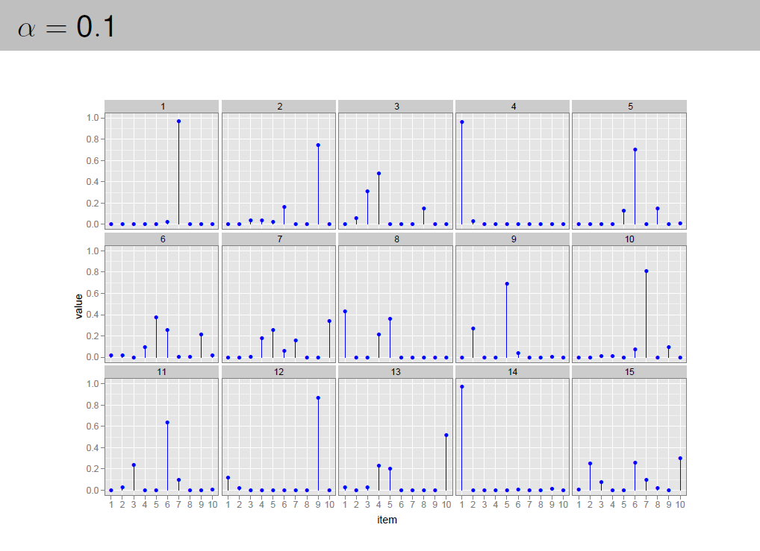

Slide 34
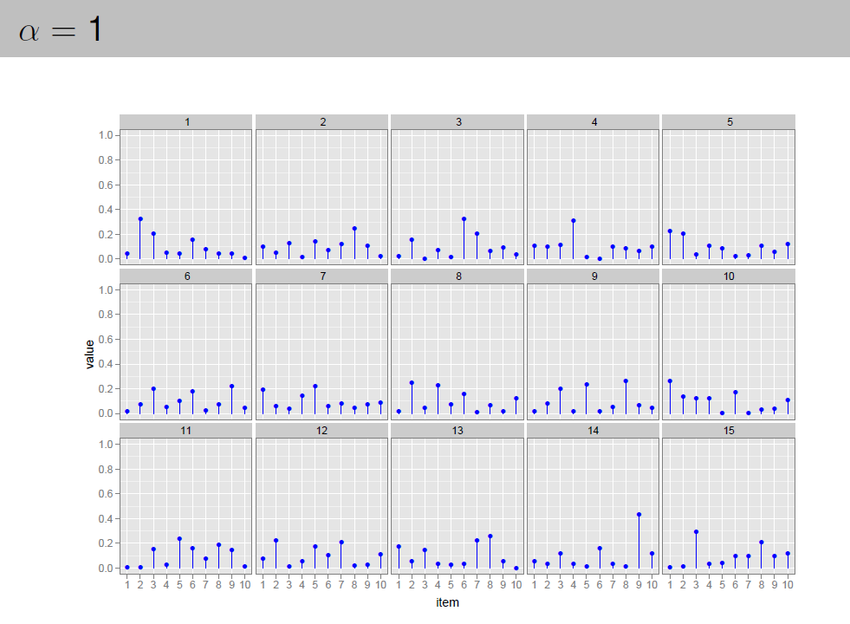

Slide 35
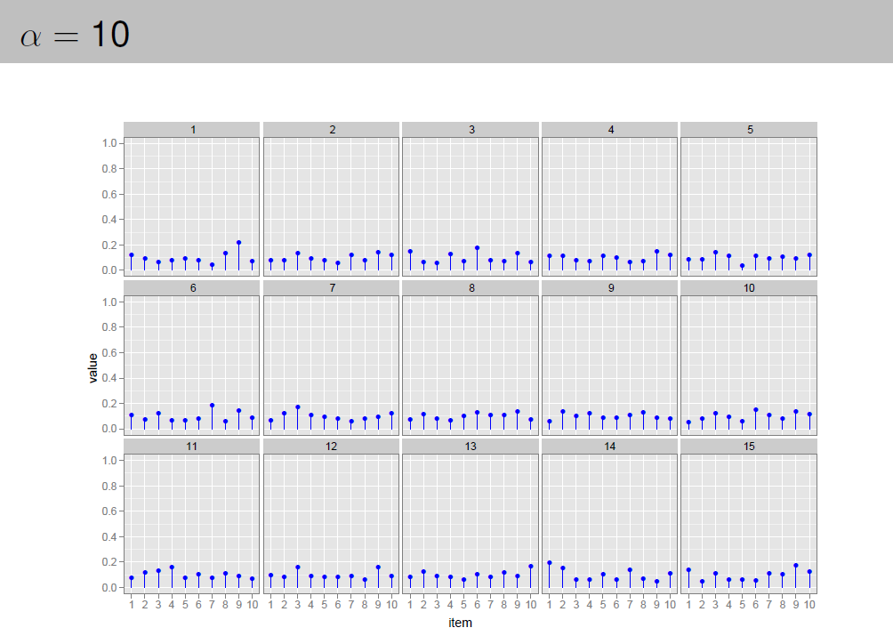

Slide 36
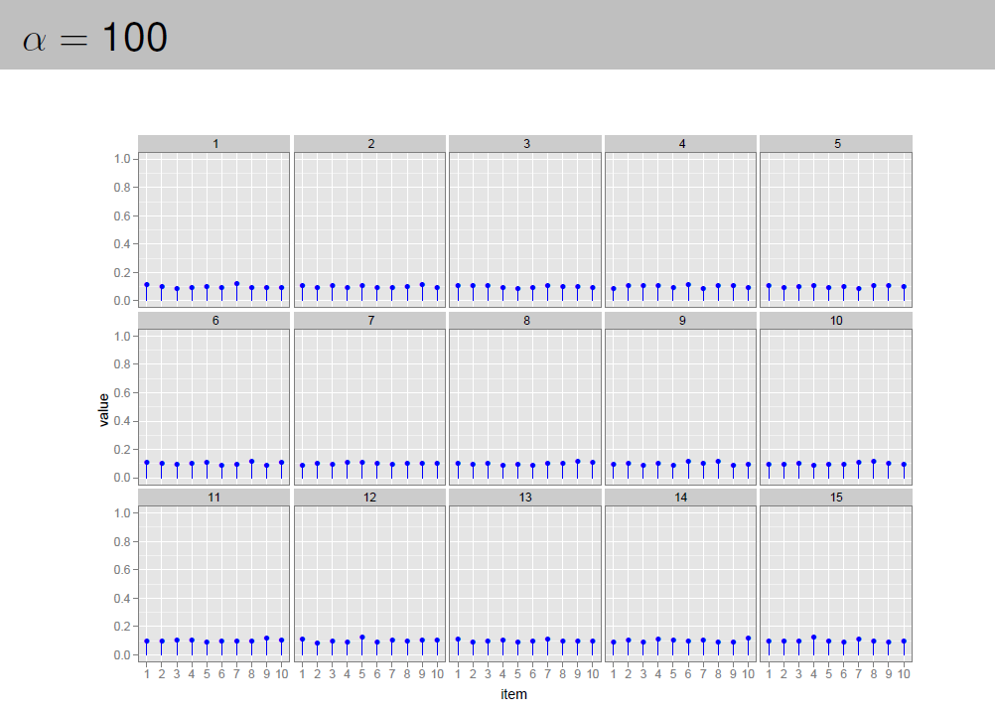

Slide 37
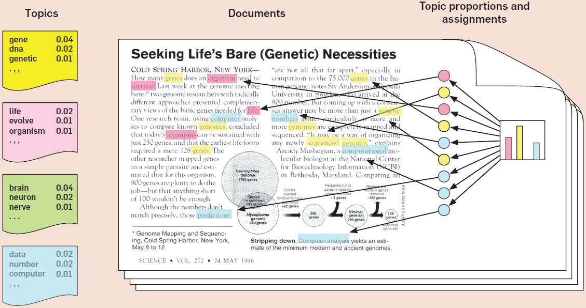
LDA, generative process illustration
37

Slide 38
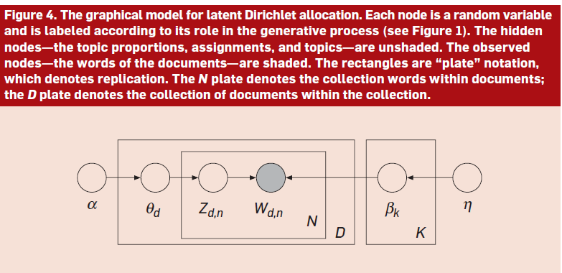
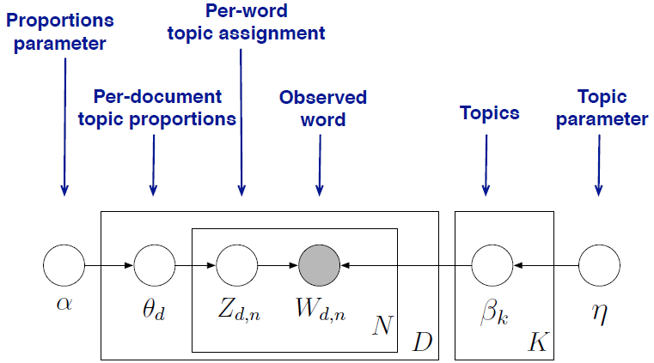
LDA, Graphical model
ϕ_{k}
β
38

Slide 39
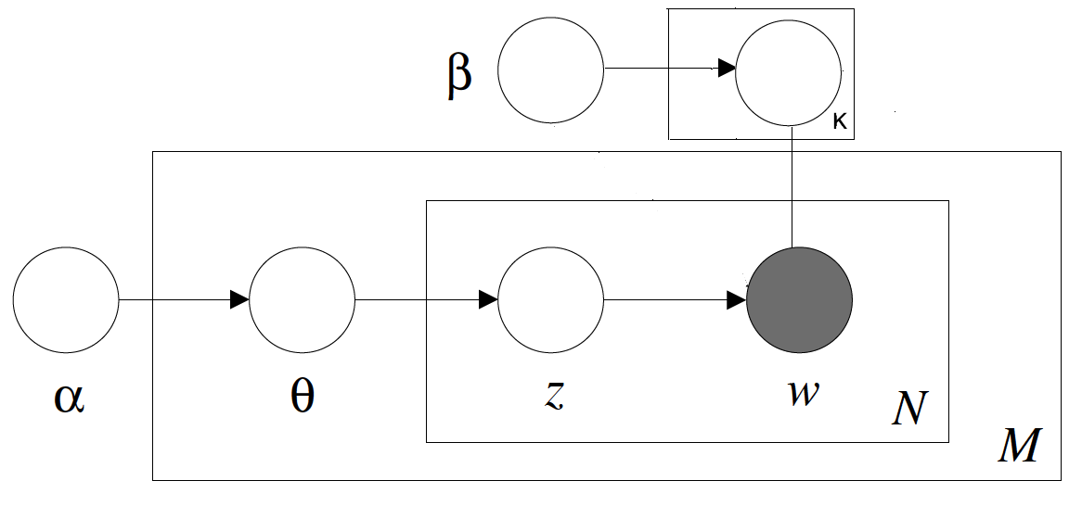
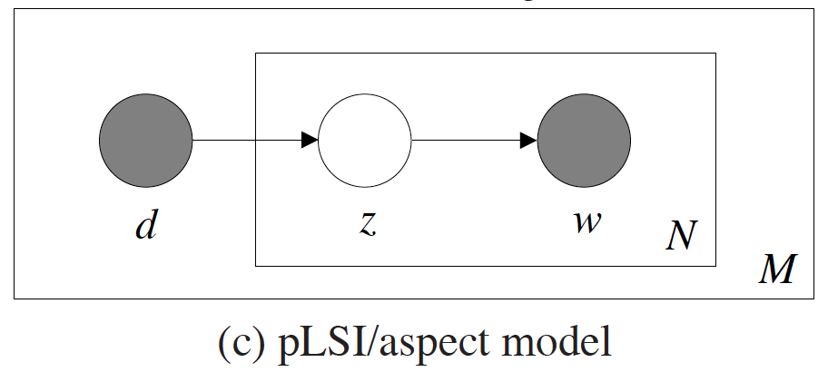
pLSI vs LDA
P(z|d):
LDA: a k-parameter hidden random variable
pLSI: a large set of individual parameters which are explicitly linked to the training set
Number of parameters:
LDA: k+k*V (not growing with training set, and less overfitting)
pLSI: k*M + k*V
ϕ
LDA model
39

Slide 40
Outline
LDA model
Model Inference
LDA discussion
40

Slide 41
Posterior Distribution
Our observed data (documents) are from the generative process including latent variables
A joint probability distribution can be defined over both the observed and latent variables P(latent, observed)
To infer the latent variables (topics), we study the posterior distribution, which is the conditional distribution of the latent variables given the observed variables: P(latent|observed)
Bayesian Inference
41

Slide 42
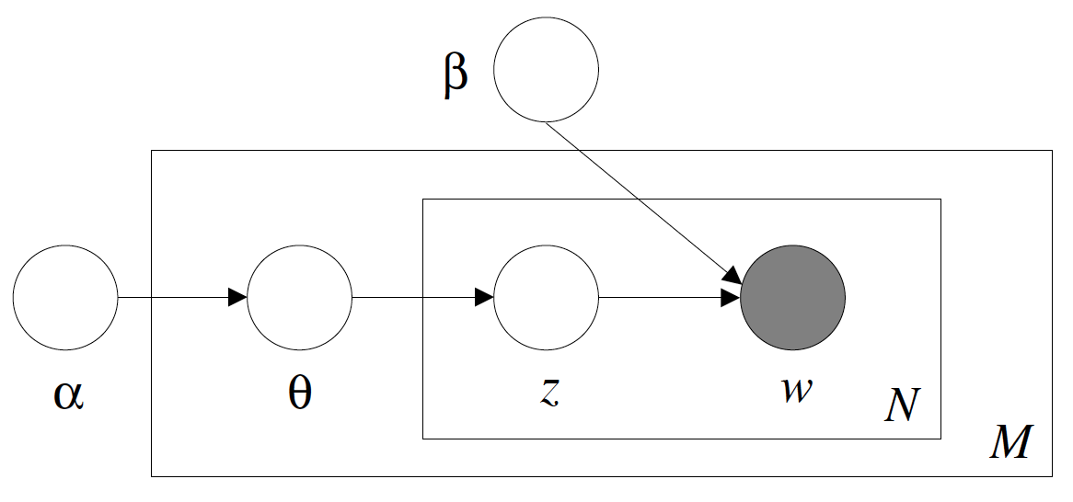
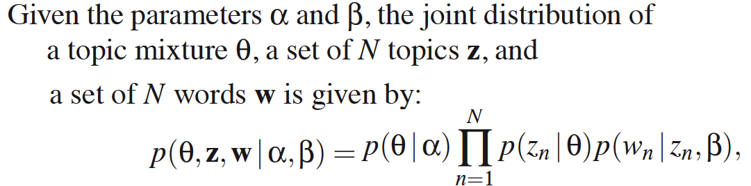
Joint distribution
42

Slide 43
Approximate Inference Techniques
Variational Algorithms
Obtain a family of lower bounds on the log likelihood.
Determine the variational parameters of low bounds by an optimization procedure that attempts to find the tightest possible lower bound.
Sampling Based Algorithms
Collect samples from the posterior to approximate it with an empirical distribution
More efficient and easy to implement
[Blei, Ng, Jordan, 2003]
[Griffiths and Steyvers, 2004]
GibbsLDA++: A C/C++ Implementation of LDA
http://gibbslda.sourceforge.net/

Slide 44
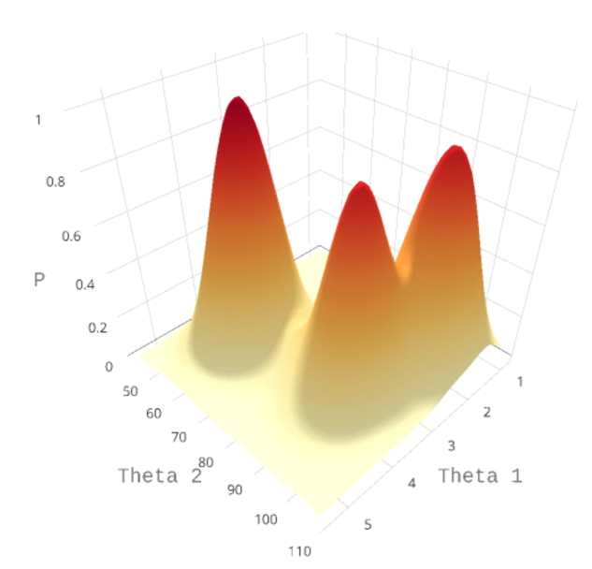
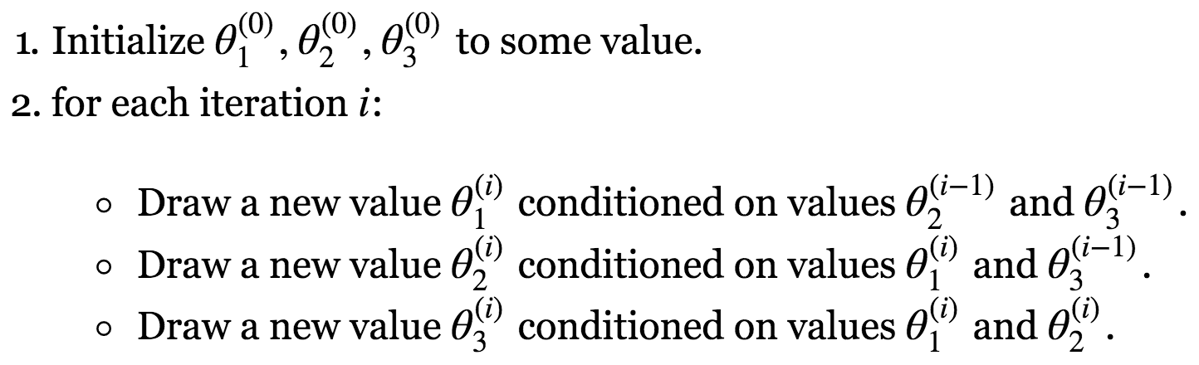
Gibbs Sampling
Finding the optimal θ*=[θ₁ θ₂] by sampling from P(θ_{1,}θ₂|D)
If P(θ_{1,}θ₂|D) is too complicated, sample from conditional distributions P(θ₁|θ₂,D) and P(θ₂|θ₁,D)
An example of three parameters,
After many iterations, infer the parameters by sample mean or mode
http://tillbergmann.com/blog/lda-gibbs-toy.html
Notes:
Gibbs sampling, a common algorithm within the Markov Chain Monte Carlo (MCMC) family of sampling algorithms

Slide 45

Gibbs Sampling for LDA
θ ~ Dirichlet (α)
φ ~ Dirichlet (β)
z_{i}|θ^{(di)} ~ Multinomial (θ^{(di)})
w_{i}|z_{i}, φ^{(zi)} ~ Multinomial (φ^{(zi)})
Alternative solution:
For each word w_{i}, estimate the topic assignment z_{i}, which is an integer value [1…K] representing the topic assigned
Then, calculate the distribution θ for each document
And, the distribution φ for each topic.
How to obtain P(z|w)? Using Gibbs Sampling, get P(z_{i}|z_{-i},w)
ϕ
http://tillbergmann.com/blog/lda-gibbs-toy.html

Slide 46
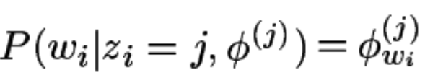
Gibbs Sampling for LDA
Estimate the topic assignment of the current word conditioned on the topic assignment on all other words:
where
The first part:
And, the second part:
The probability of w_{i} under topic j
The probability topic j in document d_{i}
https://people.cs.umass.edu/~wallach/courses/s11/cmpsci791ss/readings/griffiths02gibbs.pdf

Slide 47
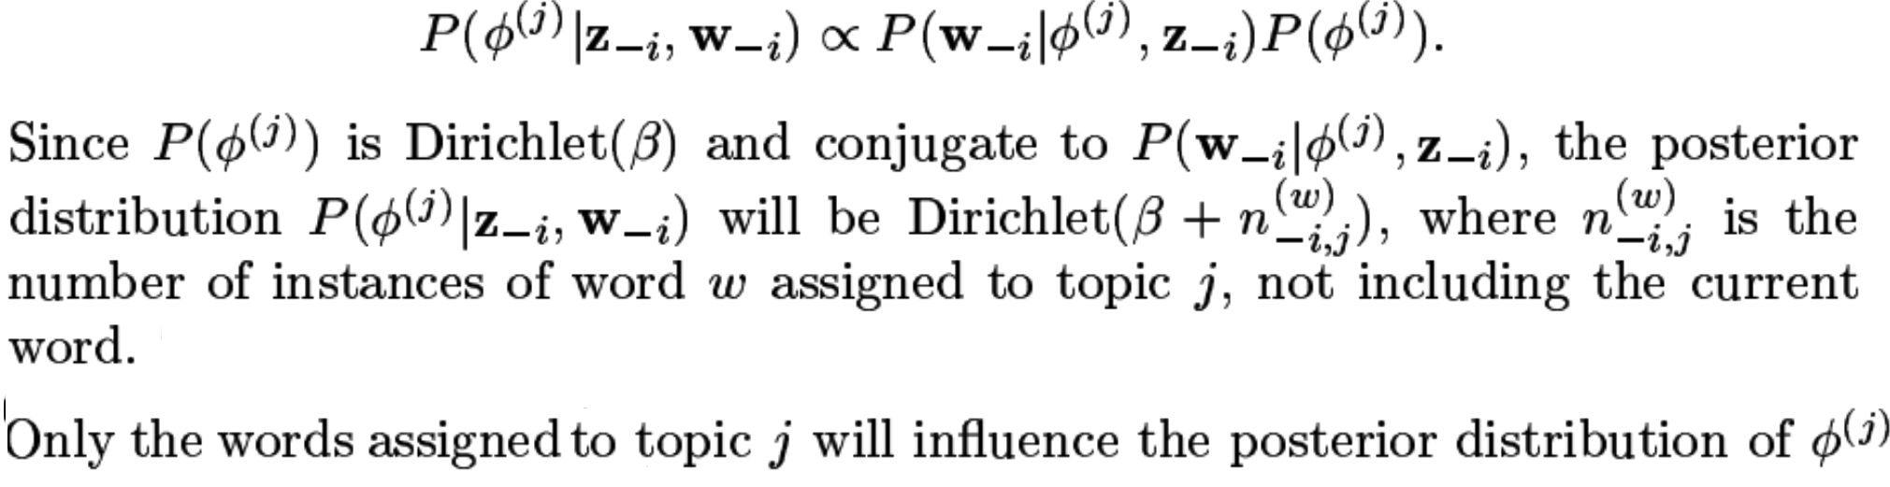
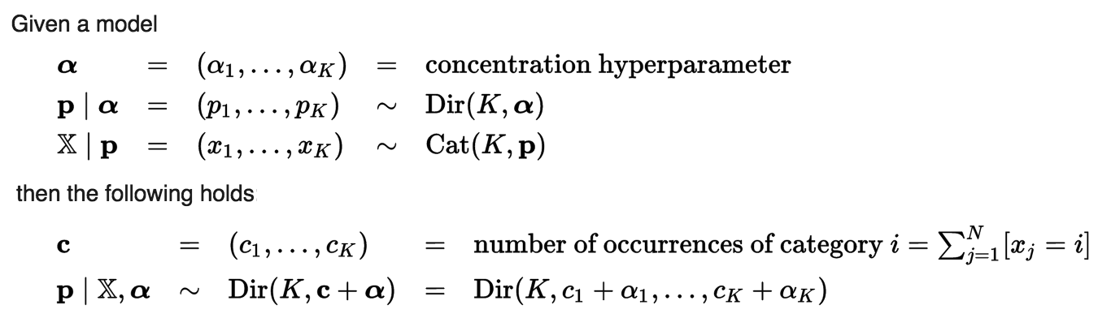
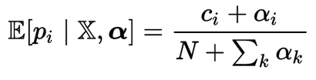
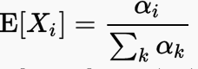
And, the second part:
NOTE: Bayesian inference using conjugate prior:
And, expected value (the expected probability of seeing category i):
Because Dirichlet mean:

Slide 48
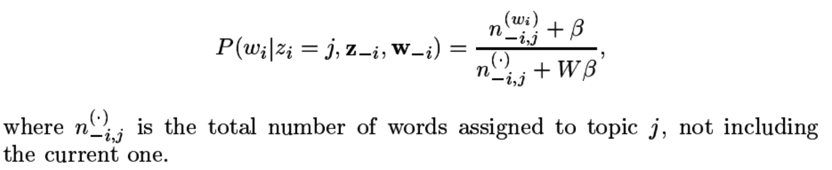
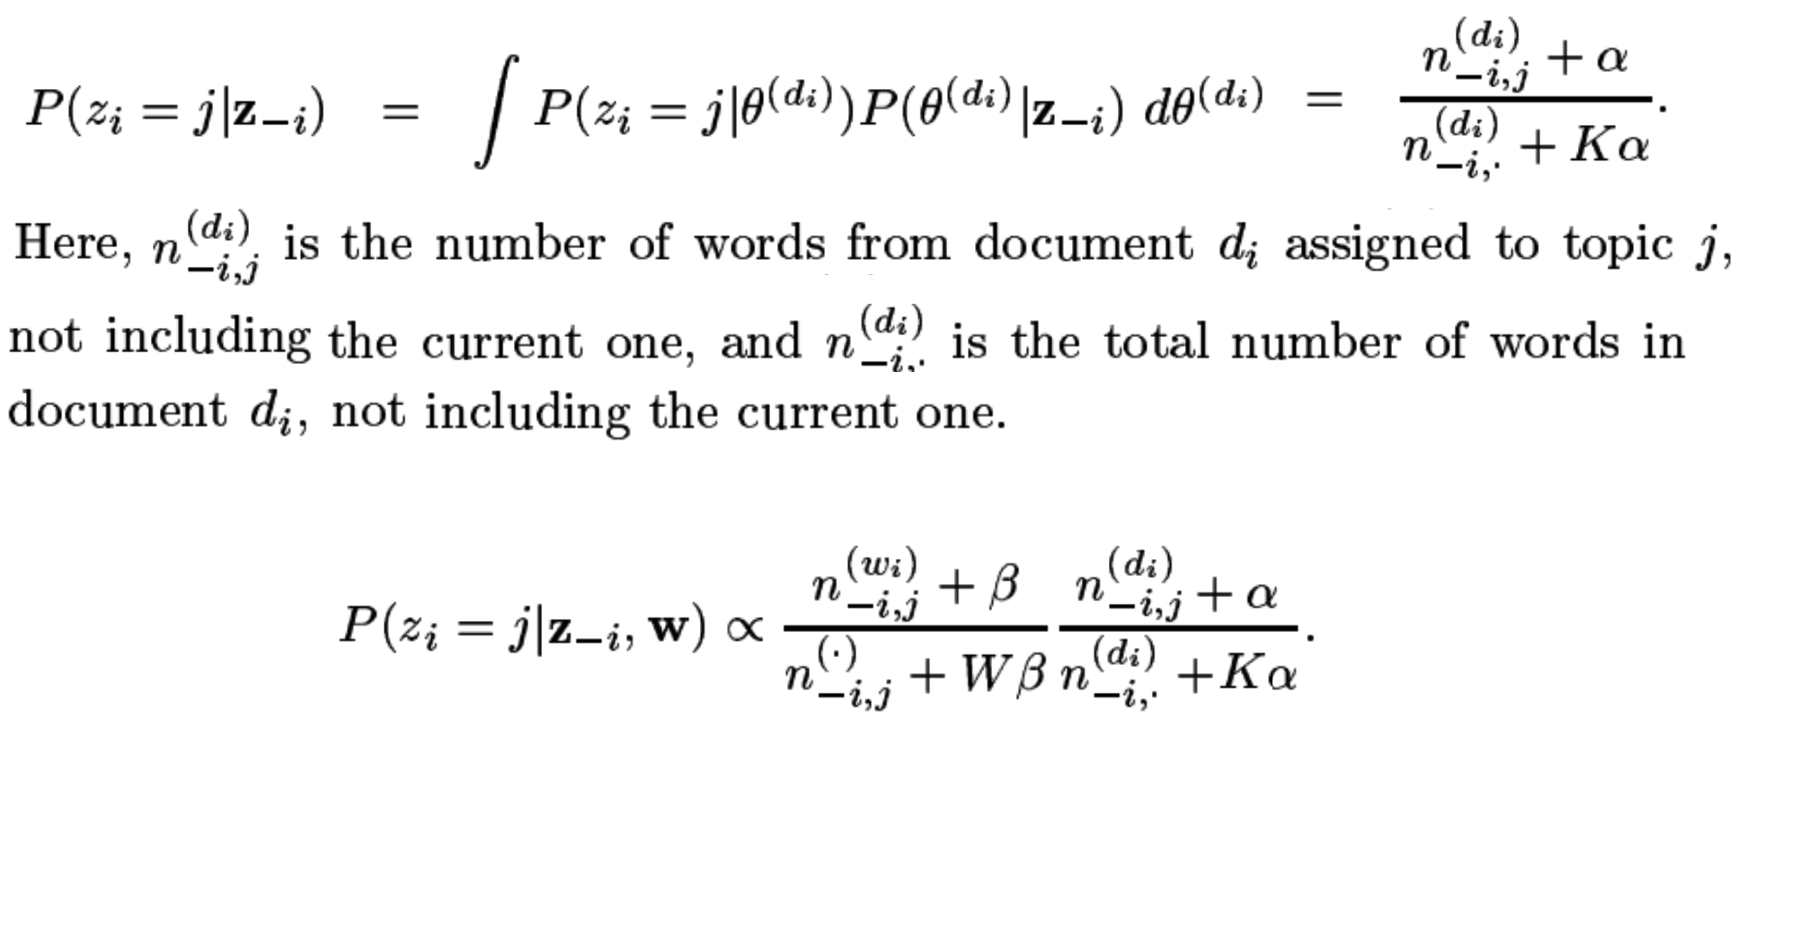
The probability of w_{i} under topic j
The probability topic j in document d_{i}
Thus,
Similarly,
Finally,

Slide 49
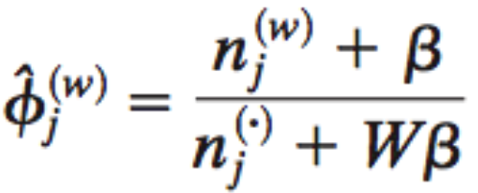
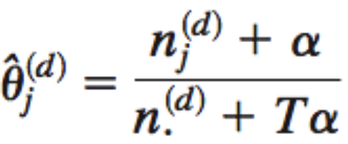
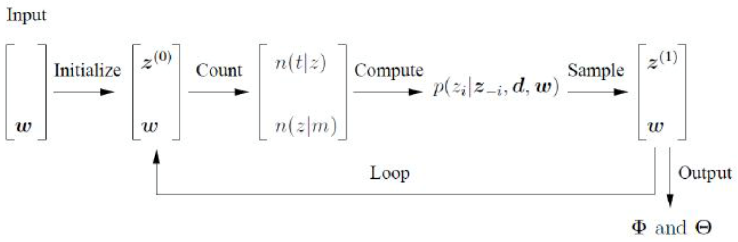
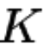
The procedure of learning LDA by Gibbs sampling
Assign each word w_{i} a random topic [1…K]
For each word w_{i}:
Decrement count matrices C^{WT} and C^{DT} by one for current topic assignment.
Sample a new topic from the posterior equation.
Update count matrices C^{WT} and C^{DT} by one with the new sampled topic assignment.
Repeat above steps until converge.
Calculate φ and θ based on C^{WT} and C^{DT}

Slide 50
Outline
LDA model
Model Inference
LDA discussion
50

Slide 51
LDA relevant
The hyper-parameter
The K
Supervised learning
Sparse data
Scalability
51

Slide 52
Interesting papers about LDA
J. D. Mcauliffe and D. M. Blei, “Supervised Topic Models”. NIPS, 2007.
H. M. Wallach, D. M. Mimno, and A. McCallum, “Rethinking LDA: Why priors matter”. NIPS, 2009.
J. Tang, Z. Meng, X. Nguyen, Q. Mei, and M. Zhang, “Understanding the limiting factors of topic modeling via posterior contraction analysis”. ICML, 2014 (Best paper award)
X. Cheng, Y. Lan, J. Guo, and X. Yan, “BTM: Topic modeling over short texts”. TKDE, 2014.
Zuo et al. “Topic Modeling of Short Texts: A Pseudo-Document View”. KDD, 2016
52

Slide 53
Applications

Slide 54
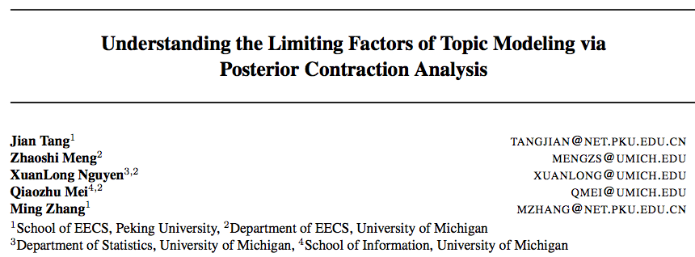
The number of documents plays perhaps the most important role; it is theoretically impossible to guarantee identification of topics from a small number of documents, no matter how long. Once there are sufficiently many documents, further increasing the number may not significantly improve the performance, unless the document length is also suitably increased.
The length of documents also plays a crucial role: poor performance of the LDA is expected when documents are too short, even if there is a very large number of them.
When a very large number of topics than needed are used to fit the LDA, the statistical inference may become inescapably inefficient. In theory, the convergence rate deteriorates quickly to a nonparametric rate, depending on the number of topics used to fit the LDA. This implies, in practice, the user needs to exercise extra caution to avoid selecting overly large number of topics for the model.
The LDA performs well when the underlying topics are well-separated in the sense of Euclidean metric; e.g., the topics are concentrated at a small number of words. And individual documents are associated mostly with small subsets of topics.
If it is believed that each document is associated with few topics, the Dirichlet parameter of the document-topic distributions should be set small (e.g. α ≈ 0.1). If the topics are known to be word-sparse, the Dirichlet parameter of the word distributions β is set small (e.g., 0.01), in which case learning is efficient.

Slide 55
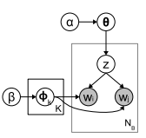

LDA for short text
TKDE’14: model the word co-occurrence patterns (i.e., biterms) explicitly,and use the aggregated word co-occurrence patterns in the corpus for topic discovering, which avoids the problem of sparse patterns at document-level.
KDD’16: Introduce the concept of pseudo document to implicitly aggregate short texts against data sparsity. i.e., modeling the topic distributions of latent pseudo documents rather than short texts
55

Slide 56


Gibbs Sampling for LDA
Estimate the topic assignment of the current word conditioned on the topic assignment on all other words:
The probability of w_{i} under topic j
The probability topic j in document d_{i}
http://tillbergmann.com/blog/lda-gibbs-toy.html

Slide 57

Applications

Slide 58
LDA-Based Document Models for Ad-hoc Retrieval
Method
LDA topic model
LDA-based Retrieval
Complexity

Slide 59

LDA retrieval model
Query likelihood model

Slide 60
LDA retrieval model
Query likelihood model
Combine LDA model with cluster retrieval model

Slide 61


LDA retrieval model
For each document d:

Slide 62

LDA-Based Document Models for Ad-hoc Retrieval
Experimental setup

Slide 63

LDA-Based Document Models for Ad-hoc Retrieval

Slide 64
Topic models for query expansion
Method
Experiments
Conclusion

Slide 65
Topic models for query expansion
Method
Experiments
Conclusion

Slide 66
Query expansion
Reformulating a seed query to improve retrieval performance
Finding sy.nonyms of words, and searching for the synonyms as well
Finding all the various morphological forms of words by stemming each word in the search query
Fixing spelling errors and automatically searching for the corrected form or suggesting it in the results
Re-weighting the terms in the original query

Slide 67


Topic models for query expansion
Use topic models to calculate multinomial distribution for a given query q={q1, q2 …qk}
Following RM method, investigate whether topics can be used for query expansion

Slide 68
Topic models for query expansion
Method
Experiments
Conclusion

Slide 69


Slide 70
Topic models for query expansion
Method
Experiments
Conclusion

Slide 71
Topic models for query expansion
Topics discovered in the query related feedback documents can help retrieval
Topic-based methods using these query related topics for retrieval are sensitive to parameters
method that combines RM successfully improves some queries’ results

Slide 72
Outline
Review of topic models
Topic models for IR
Other applications of topic models
Conclusion & outlook

Slide 73
Topic models in social text streams
Dynamic topic modeling on social streams
User behavior modeling on Twitter

Slide 74
Topic modeling in social text streams
Dynamic topic modeling on social streams
User behavior modeling on Twitter
Personalize web search

Slide 75
Dynamic topic modeling
Social text streams: concept drifting phenomenon
Input data:
Output:
topic distribution p(z|t) at each time period t
input documents
input documents
… …
input documents

Slide 76



Application: Hierarchical multi-label classification on social text streams
Hierarchical multi-label classification
learn a hypothesis function from training data to predict a y when given input document x
Follow -property
some social texts streams belong to to hierarchical multiple labels
￼

Slide 77
Hierarchical multi-label classification on social text streams
Hierarchical multi-label classification for short documents in social streams
Learn from previous time periods, and predict an output when a new document arrives
Concept drift phenomenon
Document expansion
Dynamic topic modeling (DTMs, Blei et al 2006)
Structural learning based text classification

Slide 78
Experimental setup
Dataset
tweets related to a transportation company
from 18th January 2010 to 5th June 2012
145,692 tweets posted by 77,161 Twitter users
annotations 493 nodes in 13 subsets

Slide 79

Time-aware topic extraction (1)

Slide 80
Topic modeling in social text streams
Dynamic topic modeling on social streams
User behavior modeling on Twitter
Personalize web search

Slide 81

Application: personalized time-aware tweets summarization
Data preprocessing
Tweets propagation model
Document summarization: sentence extraction

Slide 82

Tweet Propagation Model
Key idea

Slide 83

Tweet Propagation Model
Probability of user’s interests at each time period
Probability of topics at each time period

Slide 84


Tweet Propagation Model (1)

Slide 85



Slide 86

Tweet Propagation Model (2)
Gibbs EM sampling is used in the inference process.
Derive parameter λu,c,t via Markov random walks

Slide 87

Approach

Slide 88

Overall performance

Slide 89
Topic modeling in social text streams
Dynamic topic modeling on social streams
User behavior modeling on Twitter
Personalize web search

Slide 90



Personalized web search
click documents
social networks
time

Slide 91




User based topic model

Slide 92



User based topic model

